Slide 1

📌 Project Objective:
To develop a clear, practical cybersecurity policy and an effective incident response plan tailored for small businesses, aiming to:
Protect sensitive business and customer data.
Reduce the risk of cyberattacks.
Provide a step-by-step response strategy during a security breach.
---
🔒 Part 1: Cybersecurity Policy
1.0 Purpose
To establish rules and procedures for ensuring the confidentiality, integrity, and availability of the company’s data and systems.
2.0 Scope
This policy applies to all employees, contractors, and third-party vendors who access company data or systems.
3.0 Key Policies
3.1 Acceptable Use Policy
Company devices must only be used for authorized business purposes.
Avoid accessing unauthorized websites or downloading suspicious files.
This Photo by Unknown Author is licensed under CC BY-SA

Slide 2
3.2 Password Policy
Passwords must be at least 12 characters long.
Use a mix of letters, numbers, and symbols.
Change passwords every 90 days.
3.3 Device Security
All devices must have antivirus software installed.
Enable auto-lock after 5 minutes of inactivity.
Avoid using public Wi-Fi without a VPN.
3.4 Email and Communication
Do not open emails from unknown senders.
Never click on suspicious links or download unexpected attachments.
3.5 Data Protection
Sensitive data (e.g., customer records, financial data) must be encrypted.
Backups should be made daily and stored offsite or in the cloud.

Slide 3

3.6 Access Control
Only authorized personnel may access sensitive systems.
Use two-factor authentication (2FA) for all admin accounts.
3.7 Training & Awareness
Employees must complete cybersecurity awareness training every 6 months.
This Photo by Unknown Author is licensed under CC BY-ND

Slide 4

Cybersecurity Policy & Incident Response Plan for Small Businesses
Cyber threats cost small businesses six-figure losses on average. The growing complexity of attacks demands preparedness. This presentation focuses on practical, actionable policies and response plans.

Slide 5






Why Cybersecurity Matters for Small Businesses
Rising Attack Rates
Diverse Attack Types
Approximately 39% of small businesses faced cyber-attacks in the past year (UK data). This highlights a significant and growing threat.
Attacks include ransomware, phishing, data breaches, and insider threats, each posing unique challenges.
Significant Risks
Vulnerability Gap
Financial, operational, and reputational risks are substantial, impacting business continuity and customer trust.
Small businesses are often less prepared than larger firms, making them prime targets for cybercriminals.

Slide 6
Key Components of a Small Business Cybersecurity Policy
A robust cybersecurity policy forms the foundation of your digital defence. It's not just about technology; it's about establishing clear guidelines and fostering a security-aware culture.
Security Culture: Establish a strong security culture led by the CEO and leadership team, promoting awareness and compliance.
Authentication: Implement multifactor authentication (MFA) and enforce strong, unique password policies for all accounts.
Software Hygiene: Ensure regular patching and timely software updates to address known vulnerabilities.
Data Resilience: Maintain robust data backup and recovery procedures to minimise data loss during incidents.
Network Security: Apply strict access control and network security measures, including firewalls and intrusion prevention systems.

Slide 7
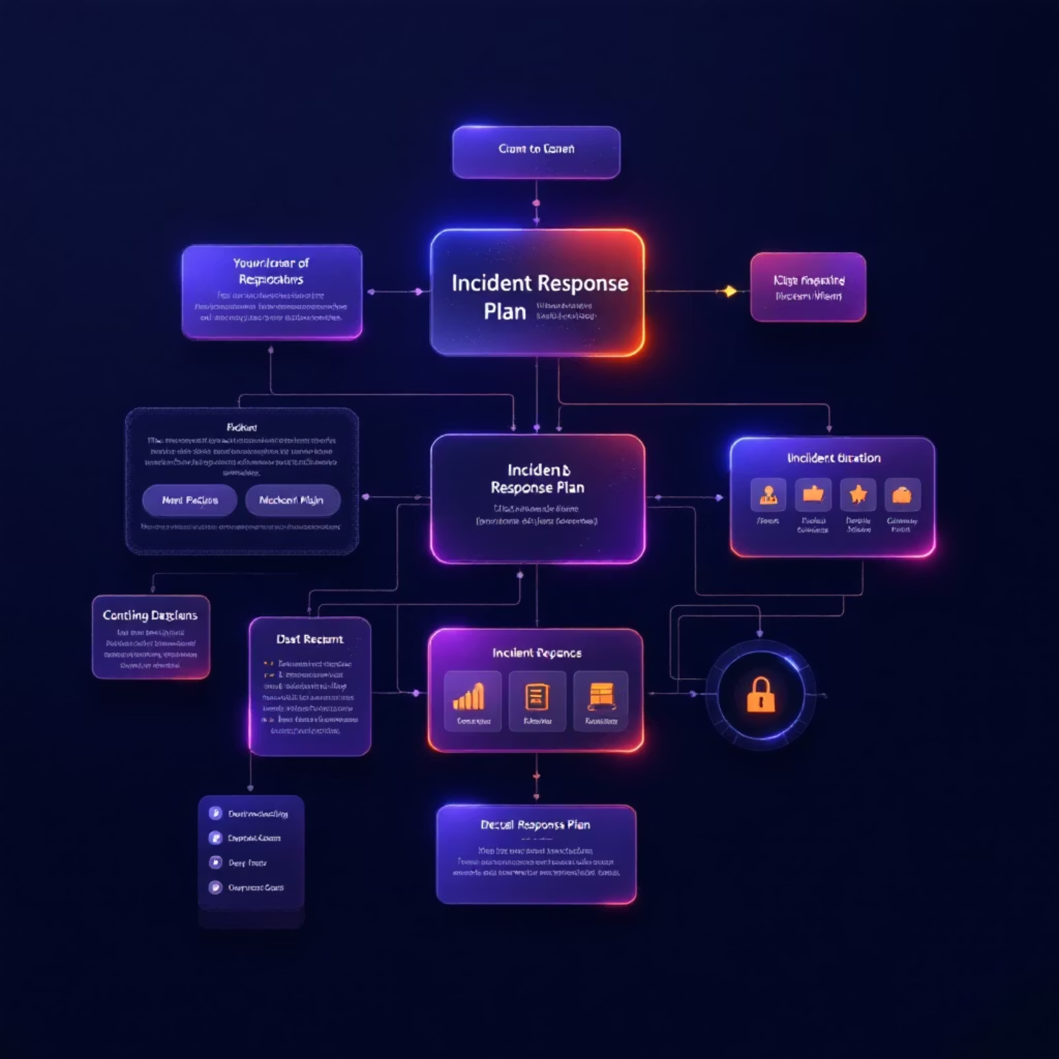
What is an Incident Response Plan (IRP)?
An Incident Response Plan (IRP) is a written blueprint detailing the actions to be taken before, during, and after a cyber incident. It is crucial for minimising damage and restoring operations efficiently.
It helps contain damage, understand threats, and restore operations.
Includes an inventory of assets, contact information, defined roles, and communication protocols.
Aligns with established frameworks like NIST, CISA, or ISO 27001 for best practices.

Slide 8





The Incident Response Lifecycle (5 Stages)
A structured approach ensures that cyber incidents are managed effectively, from initial detection to post-incident review.
Preparation
Asset inventory, risk assessment, and forming a dedicated incident response team.
Detection & Analysis
Identifying and thoroughly understanding the scope and nature of the incident.
Containment
Limiting the spread and impact of the attack to prevent further damage.
Eradication & Recovery
Removing threats from systems and restoring normal business operations.
Post-Incident Activity
Conducting a review, documenting lessons learned, and improving policies for future resilience.

Slide 9
Roles & Responsibilities in Incident Response
Effective incident response relies on clear roles and responsibilities across the organisation, ensuring coordinated and swift action.
CEO
Champion security culture, support MFA adoption, and formally approve the IRP.
Security Program Manager
Develop, update, and report on the IRP, ensuring its effectiveness.
IT Team
Responsible for detecting, containing, and technically remediating incidents.
Incident Response Team
Comprises various stakeholders including legal, communications, and senior management for strategic response.

Slide 10

Practical Steps for Small Businesses
Assign SPM: Designate a Security Program Manager, who doesn't necessarily need to be an IT expert, but understands the importance of cybersecurity.
Document IRP: Develop and document your Incident Response Plan with clear, actionable procedures.
Implement MFA: Enforce Multi-Factor Authentication (MFA) and other security hygiene practices across all staff.
Regular Backups: Conduct regular data backups and routinely verify the restoration processes.
Contact Lists: Maintain updated contact lists for both internal and external responders.

Slide 11

Tools and Best Practices

Slide 12
Testing, Training & Continuous Improvement
Regular evaluation and ongoing education are essential to maintain an effective cybersecurity posture.
Test IRP
1
Regularly test the IRP with tabletop exercises involving leadership and key personnel.
Train Employees
2
Train all employees on cybersecurity awareness, phishing recognition, and incident reporting procedures.
Review Policies
3
Review and update cybersecurity policies annually or after any significant incident to reflect new threats.
Learn from Near Misses
4
Use "near misses" as valuable learning opportunities to strengthen defenses and refine your response protocols.

Slide 13
Summary & Next Steps
Cybersecurity is a business-wide responsibility, not just for IT.
A clear cybersecurity policy and Incident Response Plan (IRP) are essential to reduce risks and minimise downtime for small businesses.
Start with leadership commitment and assign a dedicated Security Program Manager.
Utilise available templates and frameworks (e.g., CISA, NIST) to build your plan.
Schedule regular training sessions and incident response drills.
Implement MFA and strong security hygiene across the organisation.

Slide 14
✅ Final Recommendations
Review this policy every 6 months.
Conduct cybersecurity drills annually.
Assign a person responsible for compliance and updates.

Slide 15
Submitted by Rajvardhan Singh

